Slide 1
Selected topics 1
Python
Dr: Nashwa Nageh

Slide 2
Agenda
Set
Set Methods
Dictionary
Dictionary methods
Boolean
Boolean operator

Slide 3
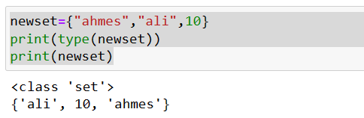
Set
Set are enclosed in curly braces
Set are not ordered and not indexed
Set indexing and slicing can’t be done
Set has only immutable data types (number, string, tuples) List and Dict are not
Set items is unique

Slide 4
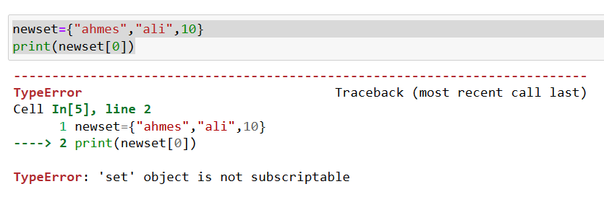
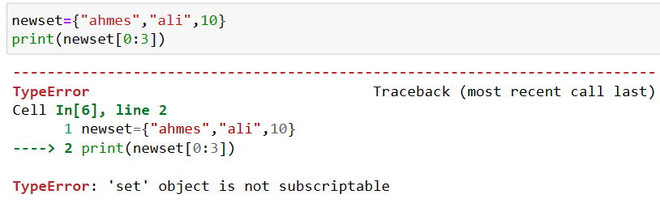
Set
Set
Set are not ordered and not indexed
Set indexing and slicing can’t be done

Slide 5
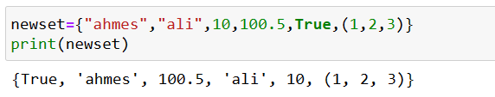
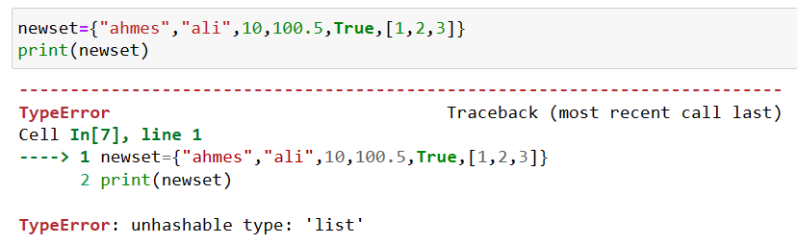
Set
Set has only immutable data types (number, string, tuples)
Unhashable type

Slide 6
What is hashing?
Hashing is the process of transforming any given key or a string of characters into another value. This is usually represented by a shorter, fixed-length value or key that represents and makes it easier to find or employ the original string.
A hash function generates new values according to a mathematical hashing algorithm, known as a hash value or simply a hash.

Slide 7
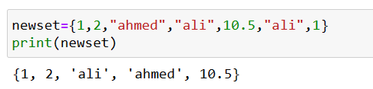
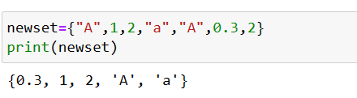
Set
Set items is unique

Slide 8
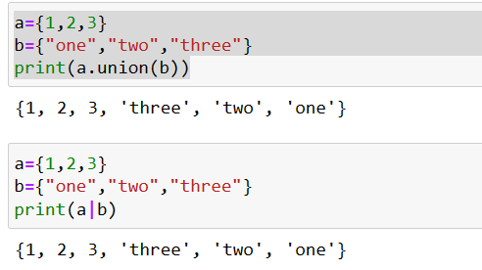
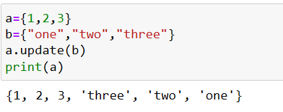
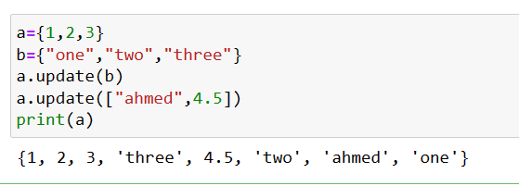
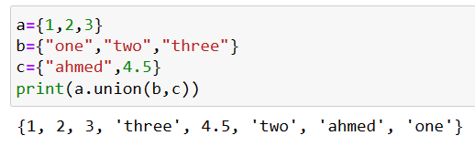
Set Methods
Union method
Update method

Slide 9
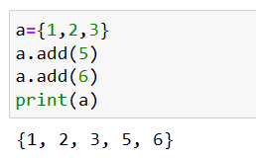
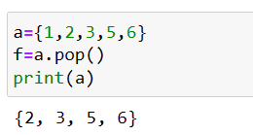
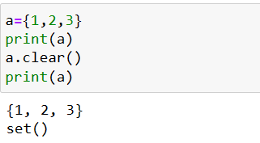
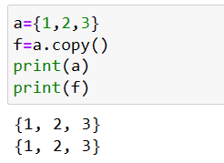
Set Methods
Add method
Pop method
removes a random item from the set.
takes exactly one argument
Clear method
Copy method
Empty set

Slide 10
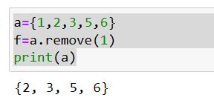
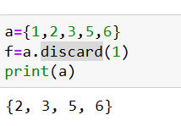
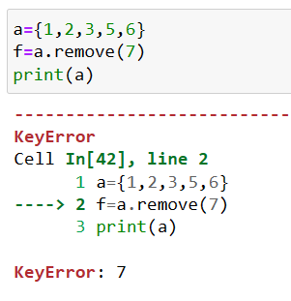
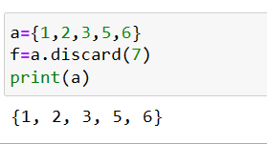
Set Methods
remove method
Discard method
Case the item exist
Case the item not exist

Slide 11
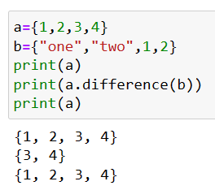
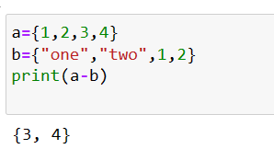
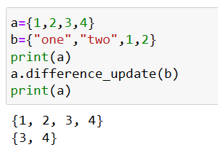
Set Methods
The difference() method returns a new set, without the unwanted items
The difference_update() method removes the items that exist in both sets.
the difference_update() method removes the unwanted items from the original set.
difference method
difference operator (-)
Difference_update method

Slide 12
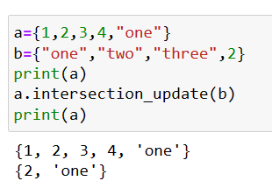
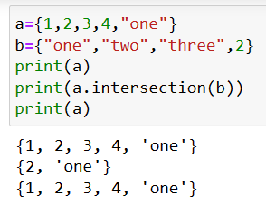
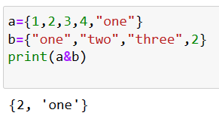
Set Methods
intersection method
intersection operator (&)
Intersection_update method

Slide 13
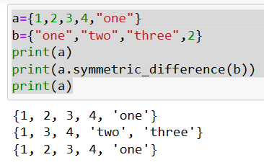
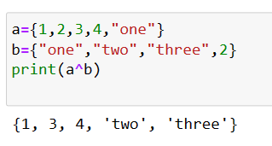
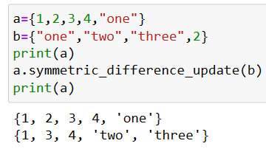
Set Methods
Symmertic_difference method
Symmertic_difference method operator (^)
Symmertic_difference _update method
The symmetric_difference() method returns a set that contains all items from both set, but not the items that are present in both sets. Meaning: The returned set contains a mix of items that are not present in both sets.
symmetric_difference_update() update the original set with the symmetric_difference items

Slide 14
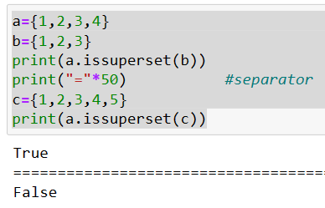
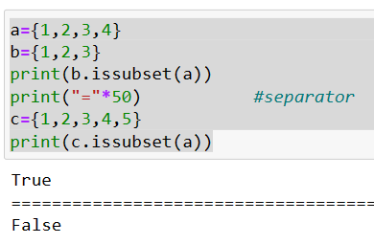
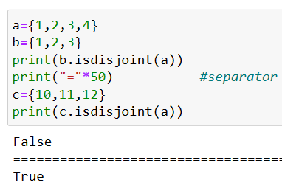
Set Methods
issuperset method
issubset method
Isdisjoint method

Slide 15
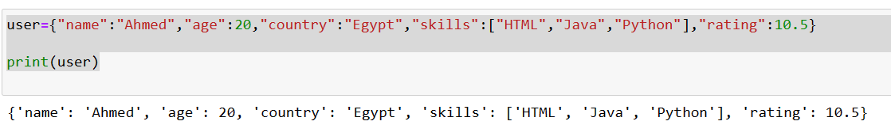
Dictionary
Dict items are enclosed in curly braces
Dict items are contains key: value
Dict key need to be immutable data types (number, string, tuples) List are not allowed
Dict value can have any data types
Dict key need to be unique
Dict is not ordered you can access its element with key

Slide 16
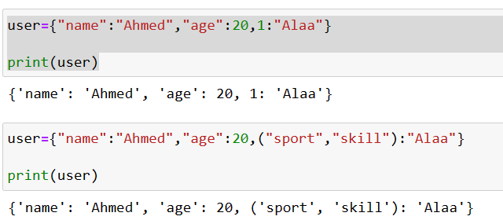
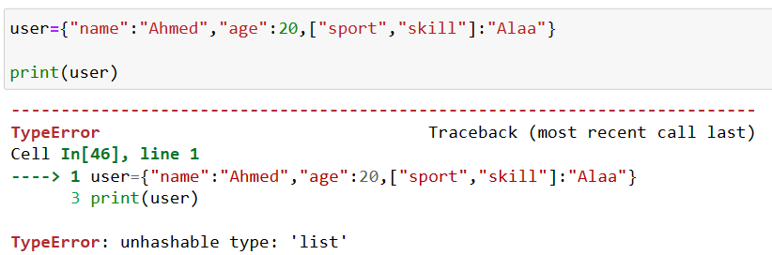
Dictionary
Dict key need to be immutable data types (number, string, tuples) List are not allowed
data types (number, string, tuples)
List are not allowed

Slide 17
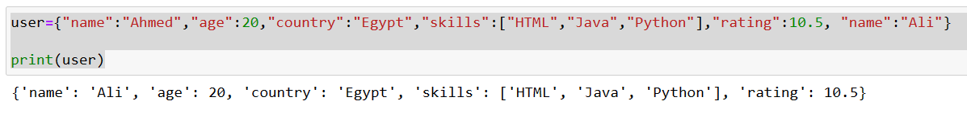
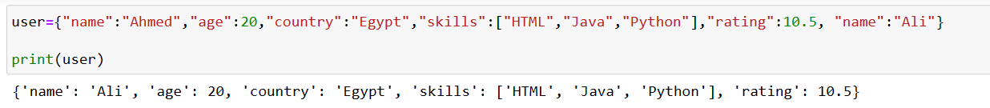
Dictionary
Dictionary
Dict value can have any data types
Dict value can have any data types
Dict key need to be unique
The last value

Slide 18
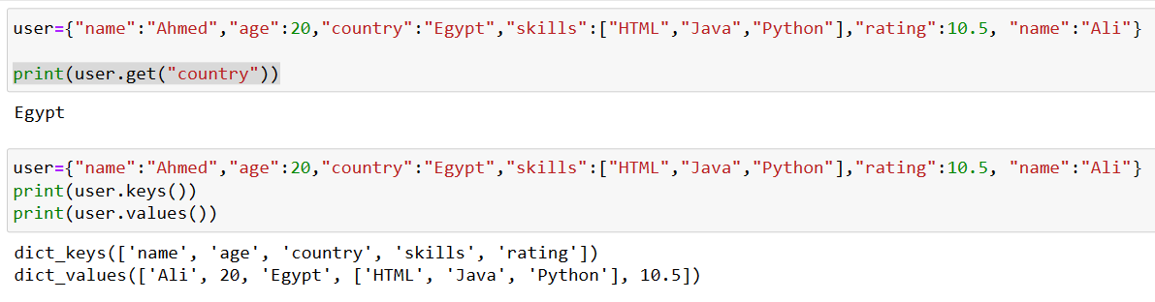
Dictionary
Dict is not ordered you can access its element with key
Dict is not ordered you can access its element with key

Slide 19
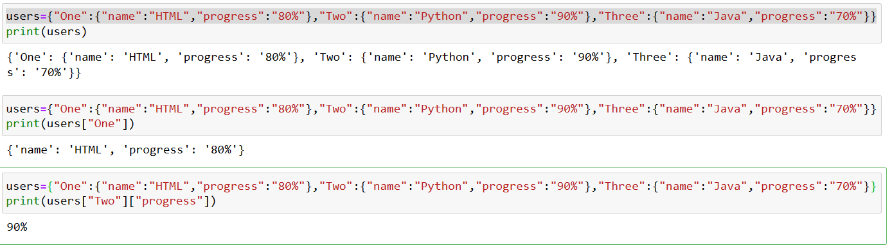
Two-dimensional Dictionary
When Dictionary value is also Dictionary

Slide 20
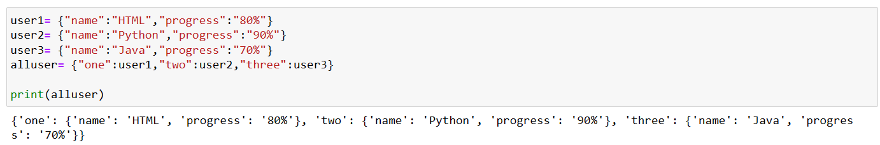
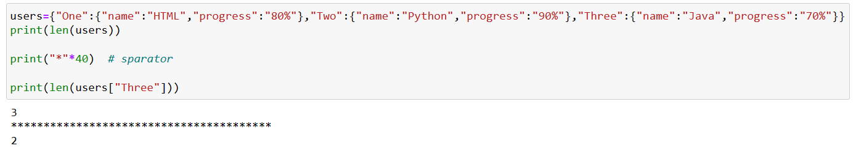
Dictionary
Dictionary length

Slide 21
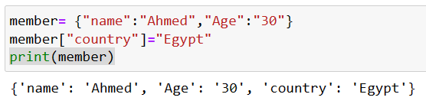
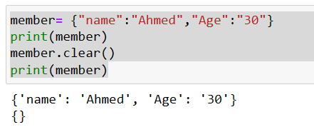
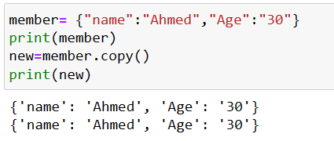
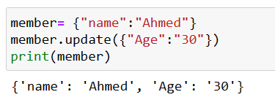
Dictionary methods
Dictionary update
Clear method
Update method
Copy method

Slide 22
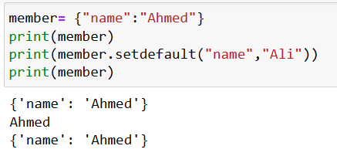
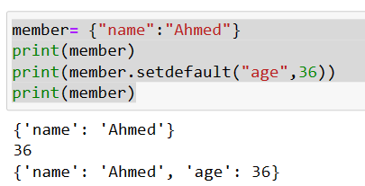
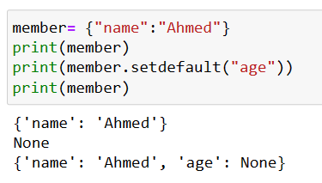
Dictionary methods
Setdefault method
The setdefault() method returns the value of the item with the specified key.
If the key does not exist, insert the key, with the specified value

Slide 23
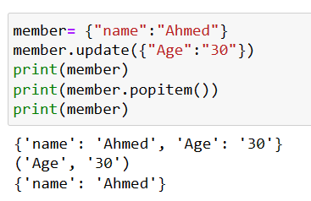
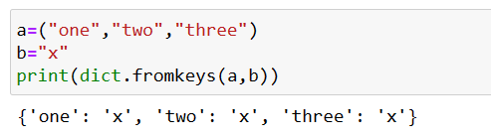
Dictionary methods
Pop method
fromkeys method
The pop() method removes the the item from the dictionary.
The value of the removed item is the return value of the pop() method
Python dictionary fromkeys() function returns the dictionary with key mapped and specific value. It creates a new dictionary from the given sequence with the specific value.

Slide 24
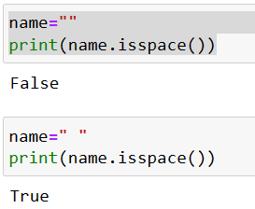

Boolean
In programming you need to known if your code output is True or False (control flow, as if conditions)
Boolean values are the two constants' objects False and True

Slide 25


Boolean
bool method
bool() in Python. Python bool() function is used to return or convert a value to a Boolean value.
True or False, using the standard truth testing procedure.
False values
True values

Slide 26




Boolean
Multiple condition
Not to reverse the logic
And operator
or operator

